Slide 1
COVID-19 Image Classification
Patient-by-Patient Approach
Kirankumar Ashokkumar

Slide 2
Table of Contents
Our Goal
Data
Models
Results
Future Endeavors

Slide 3
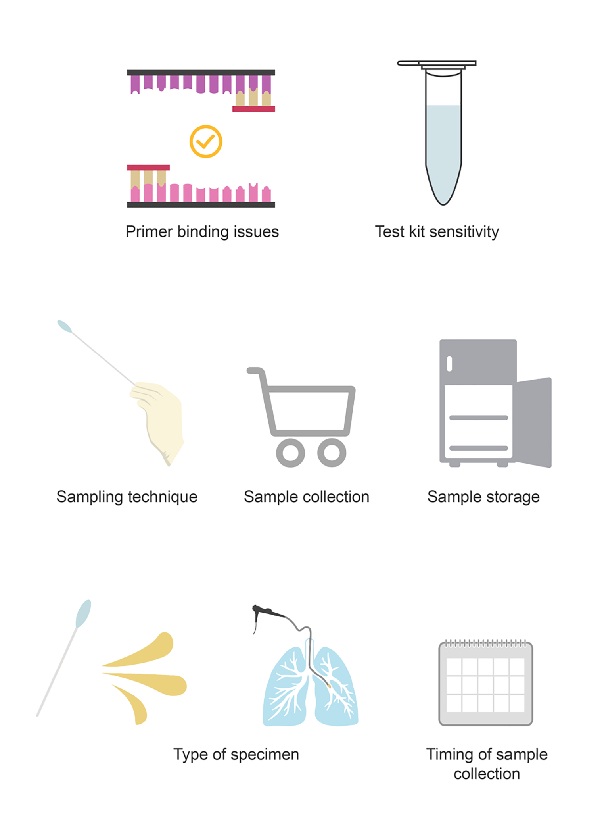
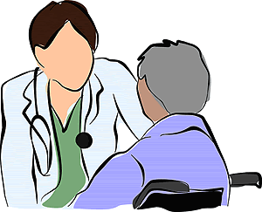
Goal/Mission
Lack of resource
Rapid Detection
Modern methodology issues
Emphasis on patient care
Notes:
Better job of context(good place to explain our of instead of doing 16 individual predictions, we can to give a clinical approach on the patient scale, optimize for a image to have covid,not a patient having covid

Slide 4
Data
COVID-CT dataset
  349 images from 216 patients
  Not the standard format dataset
SARS-CoV-2 CT-scan dataset
  2482 CT scans from 120 patients
  1252 CT scans from 60 infected patients
  1230 CT scans from 60 infected patients
Notes:
Make sure to say not standard format

Slide 5
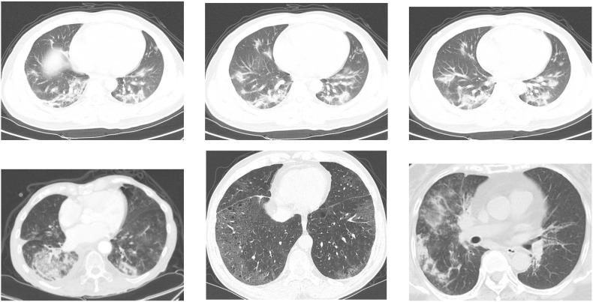
COVID CT scan examples

Slide 6
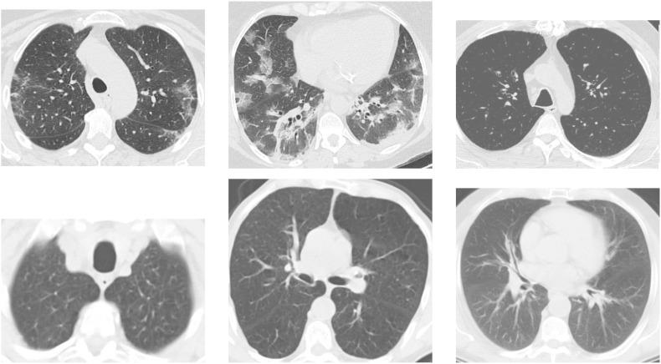
SARS-CoV-2 CT scan

Slide 7
Models
Image-by-Image (strictly single input)
AlexNet
ResNet 50
ResNet 152
Inception
Patient by Patient
Prediction model based on AlexNet with majority voting
Prediction model based on AlexNet with averaging the prediction of each scan per patient
Multi-input based on ResNet 50
Multi-input based on AlexNet
Notes:
Say something alexnet(simple model)

Slide 8
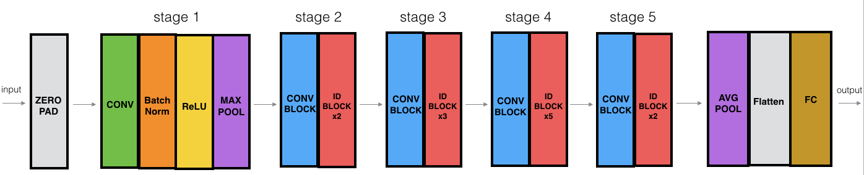
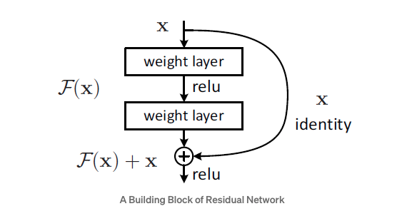
ResNet 50/152 Model
Notes:
As these networks become deeper, vanishing/exploding(dont go super deep)
When we take the partial derivative of the error function with respect to the current weight in each iteration of training,
It will multiply n of these small/large numbers to compute gradients of the front layers in a n-layer network
Even if there is vanishing gradient for the weight layers, we always still have the identity x to transfer back to earlier layers.

Slide 9
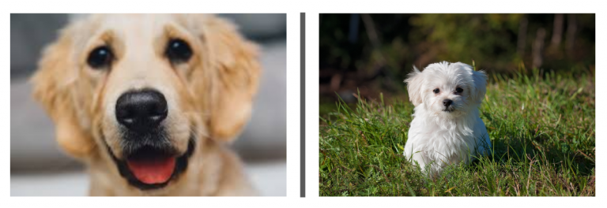
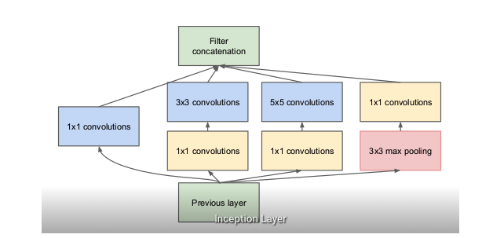
Inception Model
Notes:
Suppose, for example, a layer in our deep learning model has learned to focus on individual parts of a face. The next layer of the network would probably focus on the overall face in the image to identify the different objects present there. Now to actually do this, the layer should have the appropriate filter sizes to detect different objects
It allows the internal layers to pick and choose which filter size will be relevant to learn the required information. So even if the size of the face in the image is different (as seen in the images below), the layer works accordingly to recognize the face. For the first image, it would probably take a higher filter size, while it’ll take a lower one for the second image.
sa

Slide 10
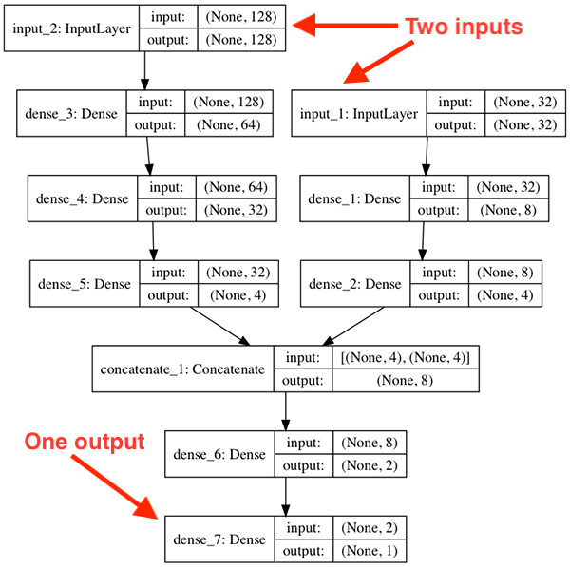
Multi-input
Notes:
Say for the other models are single, we want to patient by patient analysis so we take all their images and squeeze them through a network

Slide 11
Results for Image-by-image
 | Accuracy | F1-Score | Precision | Recall
ResNet 50 | 0.89 | 0.89 | 0.89 | 0.89
ResNet 152 | 0.92 | 0.922 | 0.92 | 0.92
Inception | 0.91 | 0.91 | 0.91 | 0.91
Alexnet | 0.90 | 0.90 | 0.90 | 0.90
Notes:
Recall: find all positive examples
F1: weighted mean between precision and recall
Precision: the ability of the network to not label a image positive when actually it is negative
Accuracy: the ratio of correctly predicted observations to the total observations
Image by image alexnet , say closer to 1 is better, make sure to mention the transfer learning

Slide 12
Patient-by-Patient approach
 | Accuracy | F1-score | Precision | Recall
Predi-alex-vote | 0.91 | 0.91 | 0.92 | 0.91
m-alex-4 | 0.58 | 0.48 | 0.55 | 0.58
m-alex-7 | 0.62 | 0.50 | 0.42 | 0.62
Predi-alex-Avg | 0.92 | 0.92 | 0.93 | 0.92

Slide 13
Data Analytics
Predicted
Prediction-AlexNet-Avg | COVID | Non-COVID
COVID | 8 | 0
Non-COVID | 2 | 15
True
Notes:
Explain what the 4 entries mean, we had 0 false negatives, we had false positives, no false negatives

Slide 14
Conclusion
Multi-input is novel idea
Patient by patient is important for future events
Leaving information behind can result in not well rounded scores
Future endeavors
  Working with more data
  Working with different models
  Multi-classification
  Different aggregation methodology

